Slide 1
Week 1
Week 1 – key concepts and JS commands
Week 1
Learning to talk to Betty

Slide 2
var name = this thing
<script src=“main.js”></script>
<script src="jquery-1.12.3.js"></script>
$(document).ready(console.log("Are we ready? Yep. I'm ready"));
<link rel="stylesheet" type="text/css" href="style.css">
var functionName = function (function variable, variable) { action wanted;
return;
}
for (var i = 0; i <= 10; i+ + 1) { console. Log( i);
}
OR
arrayName.each ???
var $newArray = $ (“element from the DOM ie the tree”)
Can then use $newArray in any way you would use an ordinary array – plus other clever jQuery
[array ] and , and .
{object } and ; and .
arrayName = [item1, item2, item3];
arrayName[ ]
arrayName [ 0 ]
arrayName.includes
arrayName.indexOf ( )
arrayName.length
arrayName.push ( );
arrayName.pop( );
arrayName.reverse
objectName = {
keyName: value;
keyName: value;
keyName:value;
}
objectName.keyName
ojbectName[“keyNameasstring”]
An object is really a table. If nest either objects or arrays in an object, get a table with multiple values
objectName – {
Key 1: {value1,value2,value3,;
Key2: (value 5, value 6);
Key3: (value7, value8)
}

Slide 3
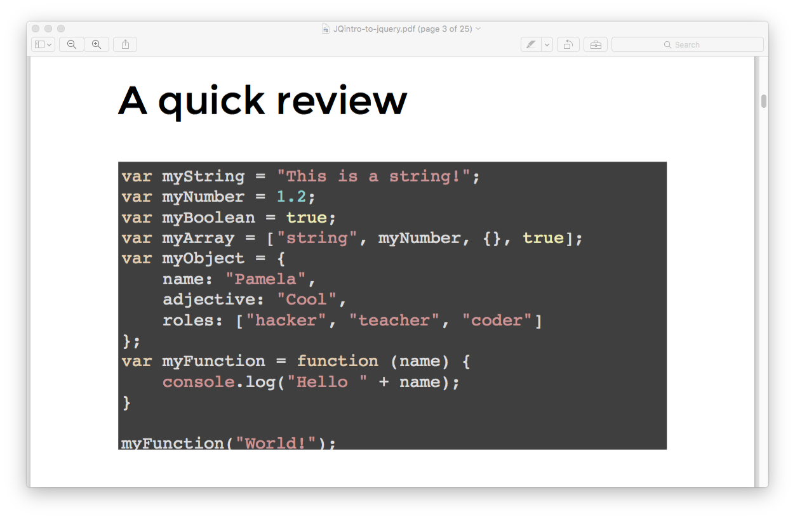

Slide 4
Data types
Variables
Temporarily remembering things and reusing them
Primitive
Composite
Numbers
Strings ""
Using data
Logical operators
Mathematical operators
var = nameOfVariable
Controlling the flow of the script
Conditionals - if, else if, else
Loops
Doing things and reusing the steps;
Functions
Declaring
Dealing with data sets
Arrays - ordered data sets. Starts counting at zero
Objects - unordered data sets
Calling it
Ending it

Slide 5
var functionName = function (function variable, variable) { action wanted;
return;
}
Functions
Declaring
Calling it
Ending it
RETURN STATEMENTS - will leave function as soon as it sees a return
var makeSilentNoise = function () { console.log( "Making 'noise'" ); };
functionName ( );
Function Name(value of variable);

Slide 6
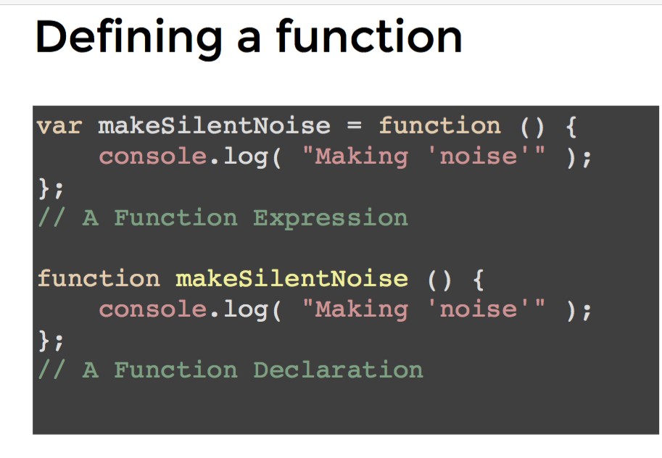
Which bit is the parameter

Slide 7
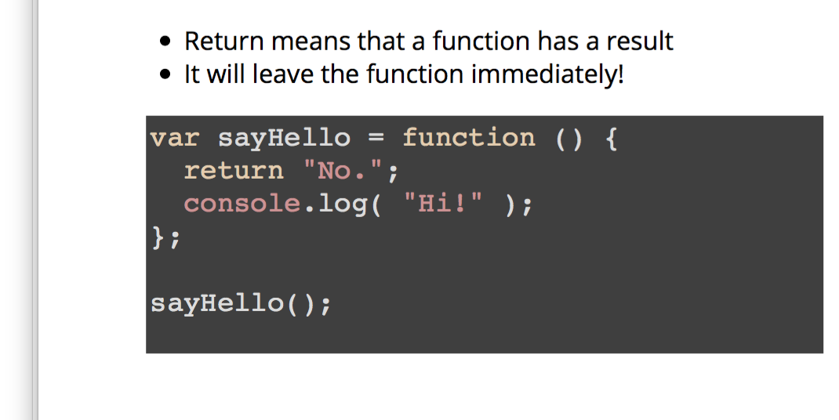
The return keyword simply gives the programmer back the value that comes out of the function. So the function runs, and when the return keyword is used, the function will immediately stop running and returnthe value.

Slide 8
Scope of variables relating to functions
Variable outside a function – can be seen by the variable inside the function
Variable in a function = can’t be seen by the variable outside the function
Fidge and camera

Slide 9
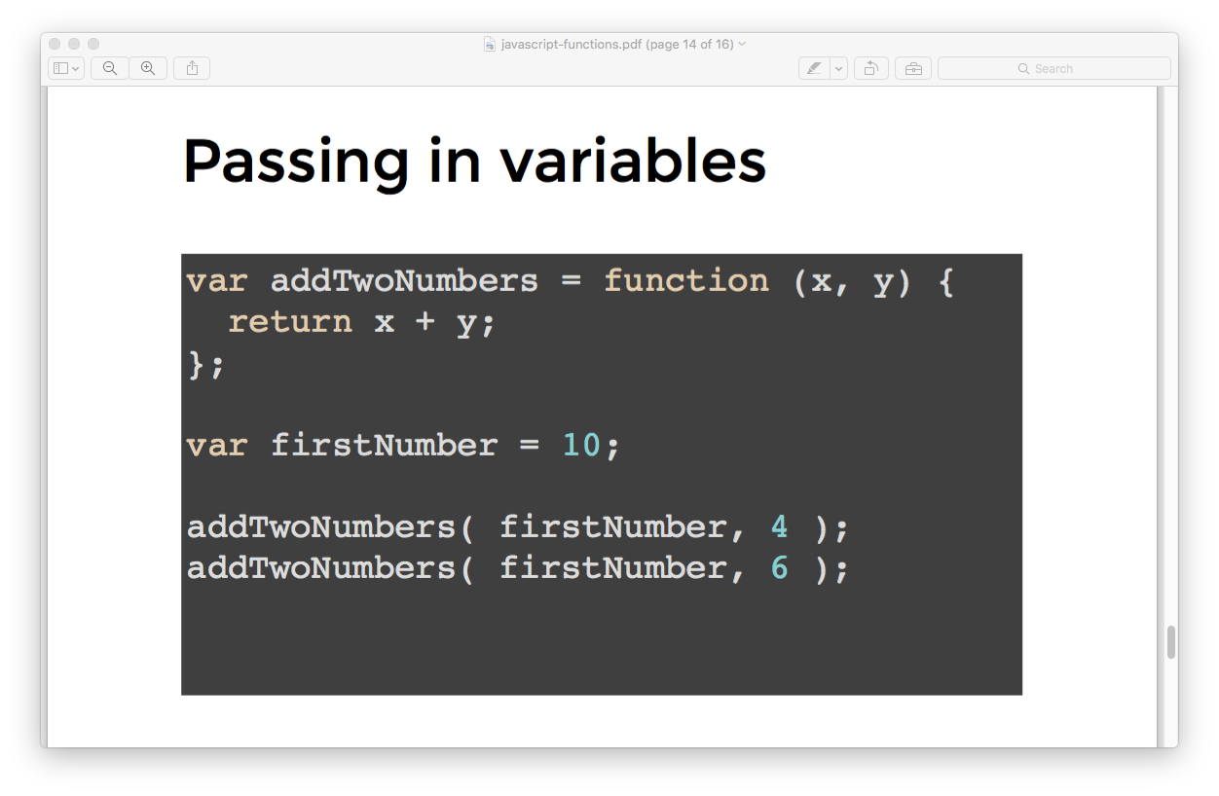

Slide 10
Controlling the flow of the script (JS)
Conditionals - if, else if, else
Loops
Start; Finish; How to calculate the finish
for (start; end; step) { // Statements to execute }
for (var countI = 0; countI <= 10; countI += 1) { console. Log( countI ); }
Betty - let me out!
for (var countI = 0; countI < 100; i++) { console.log( countI ); if ( countI === 7 ) { break; } }
Ordinary flow
Right to left
Top to bottom
jQuery
arrayName.each
This will enable you to run a function through EACH element in the array
for (var i = 0; i <= 10; i+ + 1) { console. Log( i);
}
arrayName.each ???

Slide 11
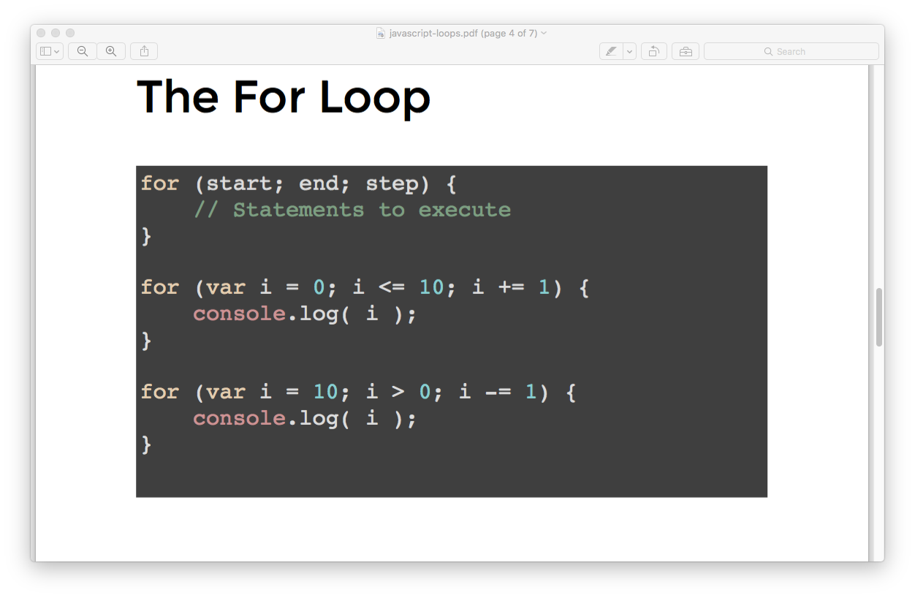

Slide 12
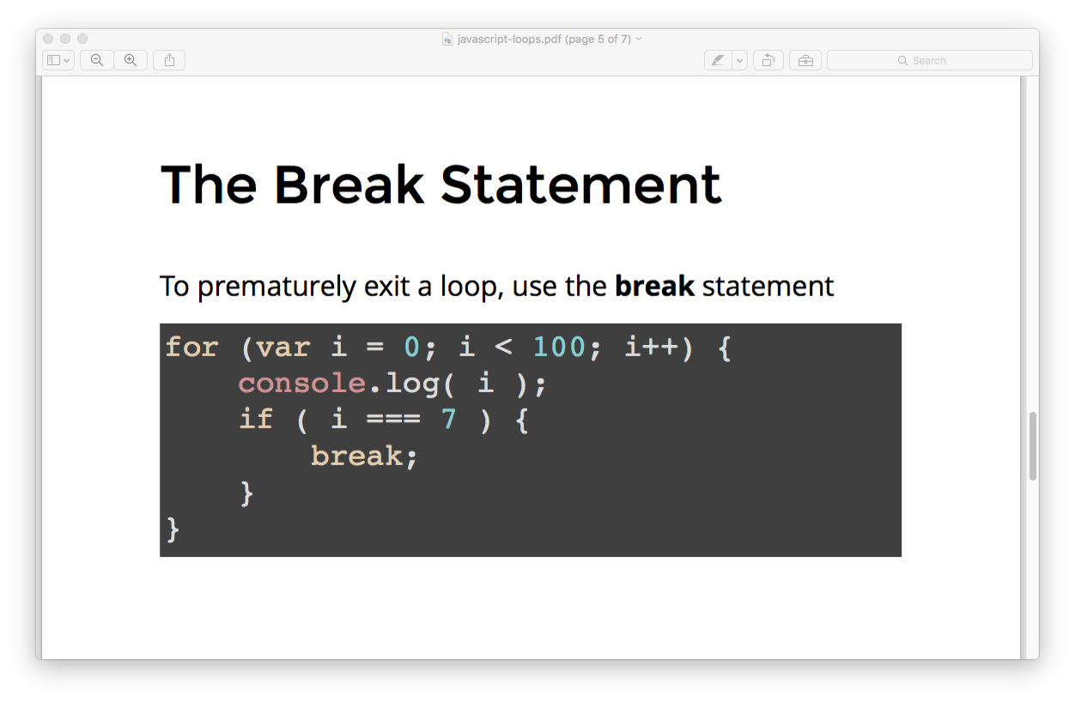

Slide 13
Declare it
for ( var counter = 0; i < array.Name.length; i++ ) { var fruit = fruits[ i ]; console.log( fruit ); }
Arrays (ordered lists)
var emptyArray = []; separate items by comma;
Loop through an array
var newFruits = fruits.slice(); // Copy everything var twoFruits = fruits.slice( 1, 3 ); // Copy from index 1 to index 3
copy everything
arrayName.indexOf ("the word or item");
arrayName.includes ("word of item");
find something
var bananaIndex = fruits.indexOf( "Banana" ); fruits.splice( bananaIndex, 1 );
from a particular spot
arranyName.pop ();
at end
arraName.shift ();
at start
Removing elements
at a particular spot
arranyName.Push (“newelement”);
at end -
arrayName.unshift ("newelements");
at start
Adding elements
arrayName[0] = "Indigo";
Changing value of array -
Access an array - arrayName [indxnumber]]
[ ] and , and .
arrayName = [item1, item2, item3];
arrayName[ ]
arrayName [ 0 ]
arrayName.includes
arrayName.indexOf ( )
arrayName.length
arrayName.push ( );
arrayName.pop( );
arrayName.reverse
An object is really a table

Slide 14
What I say | What Betty does
Console.log (arrayName) | Lists all the items in the array in square brackets
Console.log (arrayName.length) | Tell me how many things are in the array
arrayName [0] | Tell me what’s the first element in the array
arrayName.indexOf (“element name"); | Tell me what the position if - in numbers – of this particular item
ArrayName.reverse | Changes the order of the array so that it is backwards

Slide 15
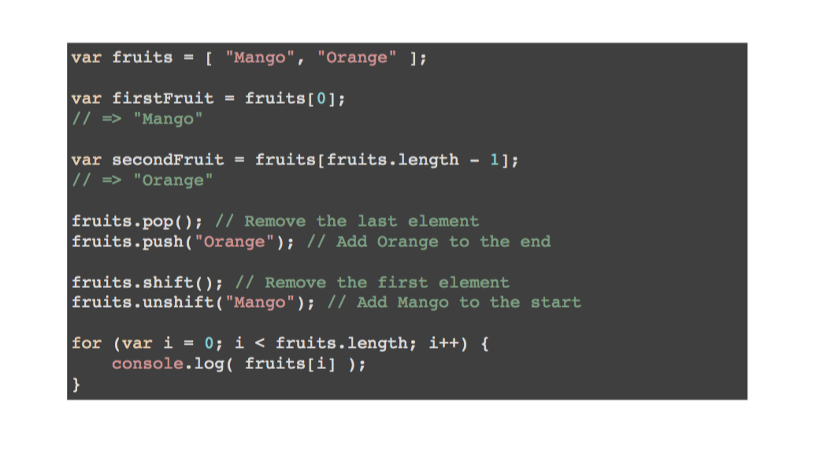

Slide 16
Objects (tables)
Access things in it
Find if something is in it
Removing things
Copy it
Declare it
var emptyObject = {key:value; key.value}; - the stuff inside the brackets is called the property
USE THE DOT objectName.property
var movieName = movie["name"]; var movieDirector = movie["director"]; var movieDuration = movie["duration"];
movie["gobbledygook"]; // => undefined
var bestCamera = { brand: "Leica", model: "M3", year: 1955, memoryCard: "SD" }; delete bestCamera.memoryCard;
delete objectName.propertyToDelete
Updating things in it
DOT NOTATION objectName.propertyName = "newValues" var movie = { name: "Satantango", director: "Bela Tarr", duration: 432 }; movie.name = "Sátántangó"; movie.director = "Béla Tarr";
Loop through it
var movie = { name: "Satantango", director: "Bela Tarr", duration: 432 }; for ( var key in movie ) { console.log( key + ": " + movie[key] ); }
eg var movieKeys = Object.keys( movie ); // => ["name", "director", "duration"]
use the name of the string of the key ojbectName["nameofkey"]
Eg var movieName = movie.name; var movieDirector = movie.director; var movieDuration = movie.duration;
{ } and ; and .
Can nest objects
Can put methods in objects

Slide 17
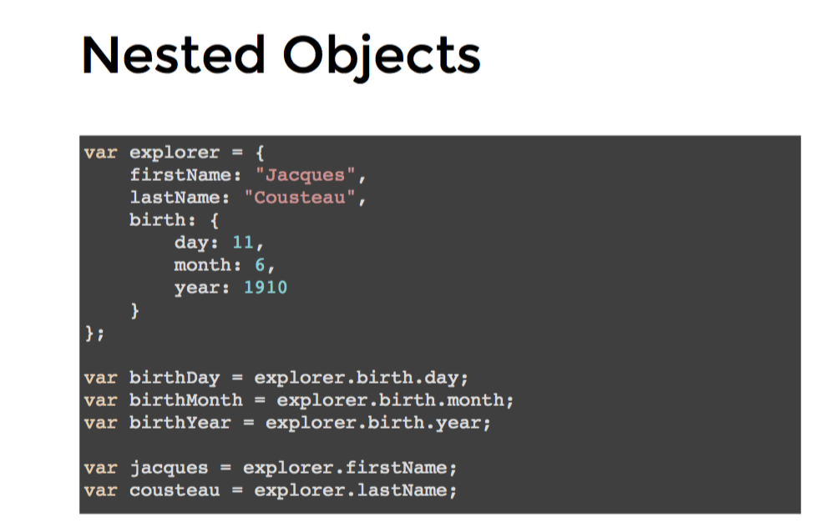
objectName = {
keyName: value;
keyName: value;
keyName:value;
}
objectName.keyName
ojbectName[“keyNameasstring”]
An object is really a table. If nest either objects or arrays in an object, get a table with multiple values
objectName – {
Key 1: {value1,value2,value3,;
Key2: (value 5, value 6);
Key3: (value7, value8)
}
Key 1 | Key 2 | Key 3
Value 1 | Value 5 | Value 7
Value 2 | Value 6 | Value 8
Value 3
Value 4

Slide 18
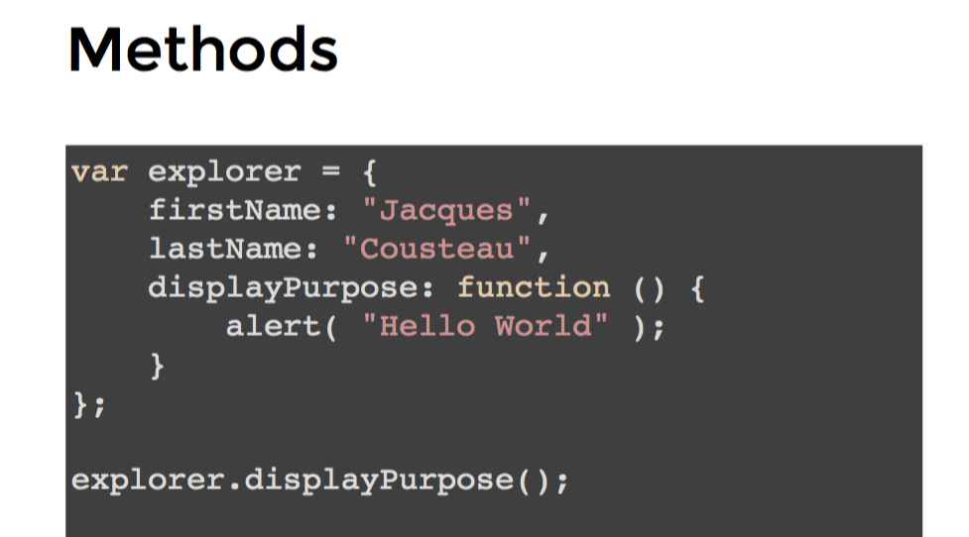
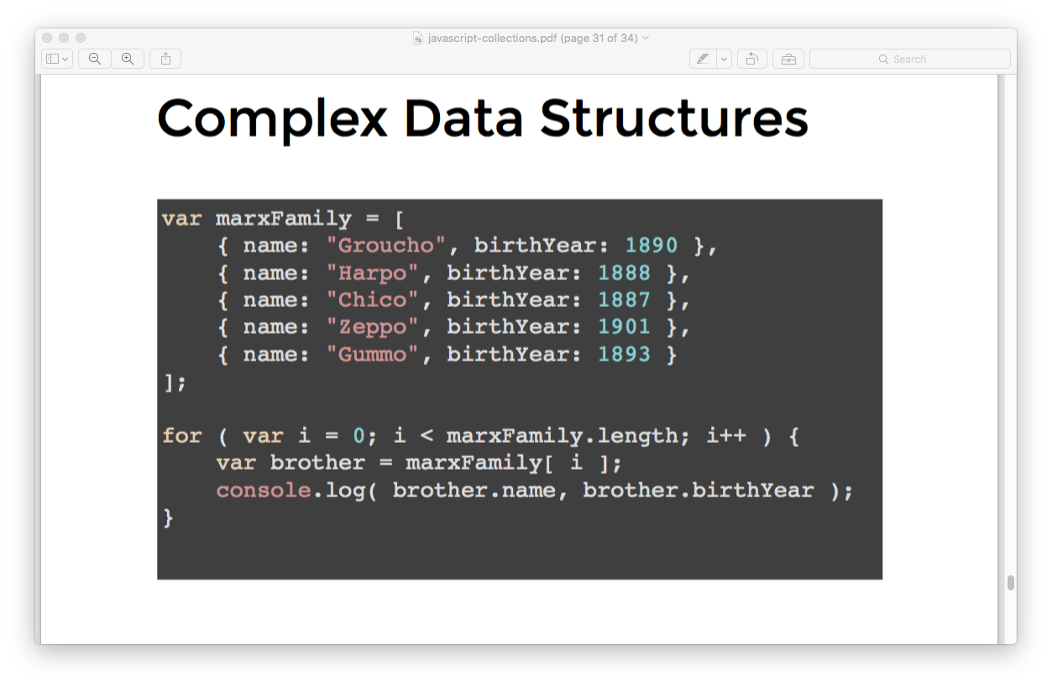
An object can contain all sorts of things

Slide 19
THIS ??????
This calls an OBJECT. What object is returned will depend on where ”THIS” is called from . Default is to call it from the window object.

Slide 20
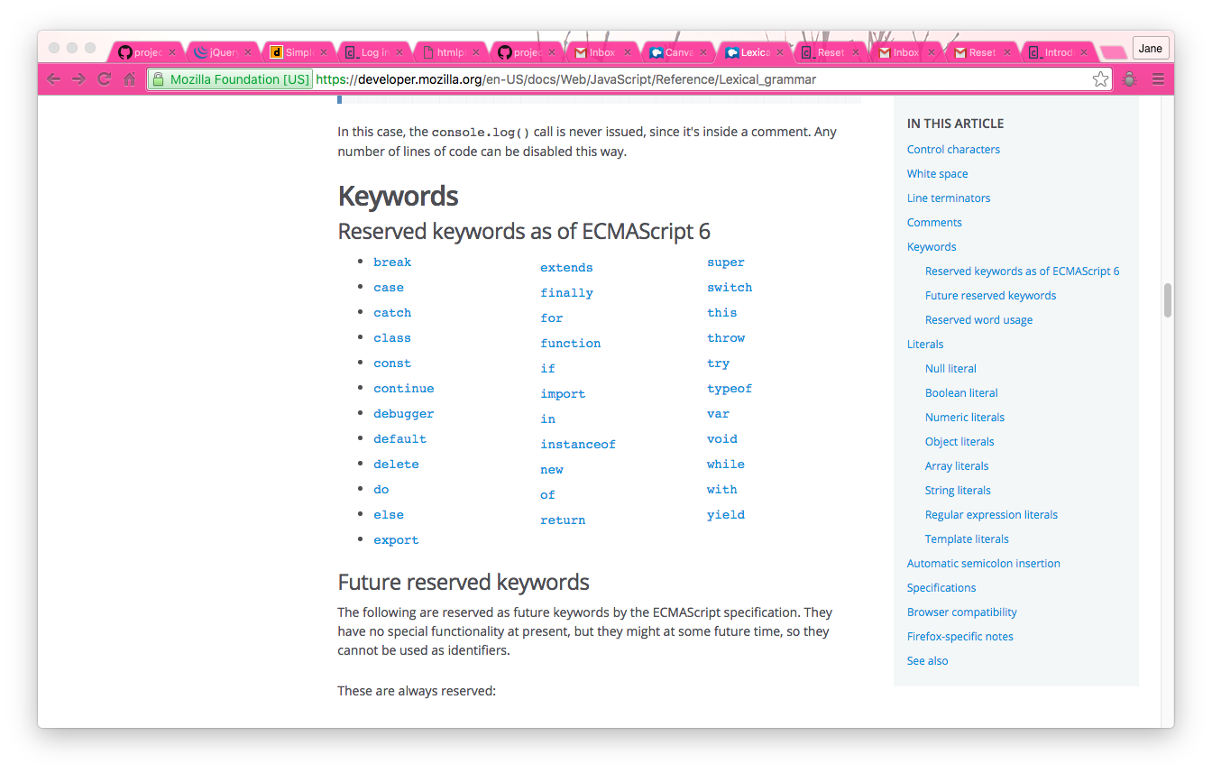

Slide 21
Factories, constructors and OLOO
Ways of creating objects easier.
When using something to create an object, capitalise the first letter
3 methods:
Factory;
Contrcutors
OLOO – Jack’s preferred “Objects linked to other objects
object.create
Generic methods
Create a specific example of the thing
var animal = {object item}???
var name = object.create (wolf) eg tamaskan.breed = "tamaskan"

Slide 22
How to access the DOM – mostly use jQuery.
Can also do it via “document.thingy” eg
document.querySelector
document.querySelectorAll
document.getElementById
document.getElementsByTagName
THE DOM and the Window
The DOM (document object model) – a big collection of all the stuff in the page
JS
CSS
HTML
Window object - contains all the stuff about the browser

Slide 23
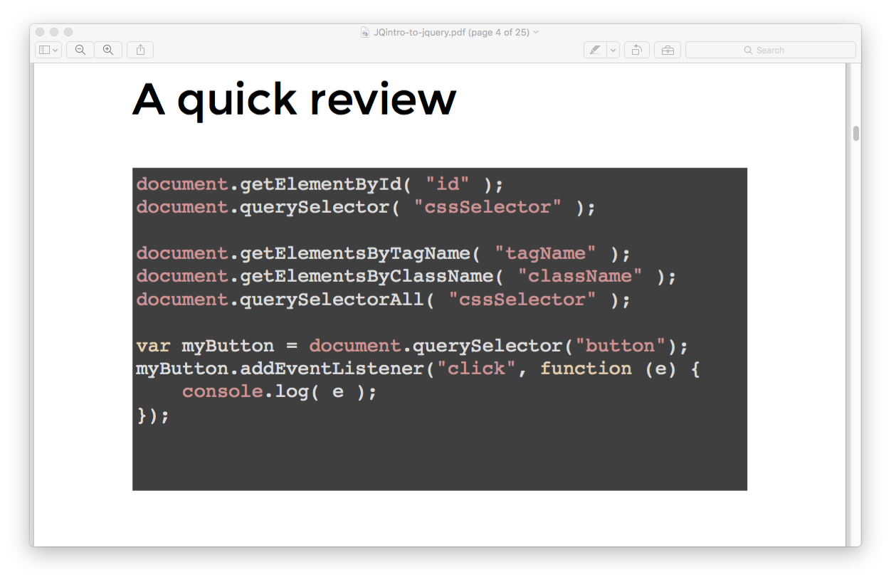

Slide 24
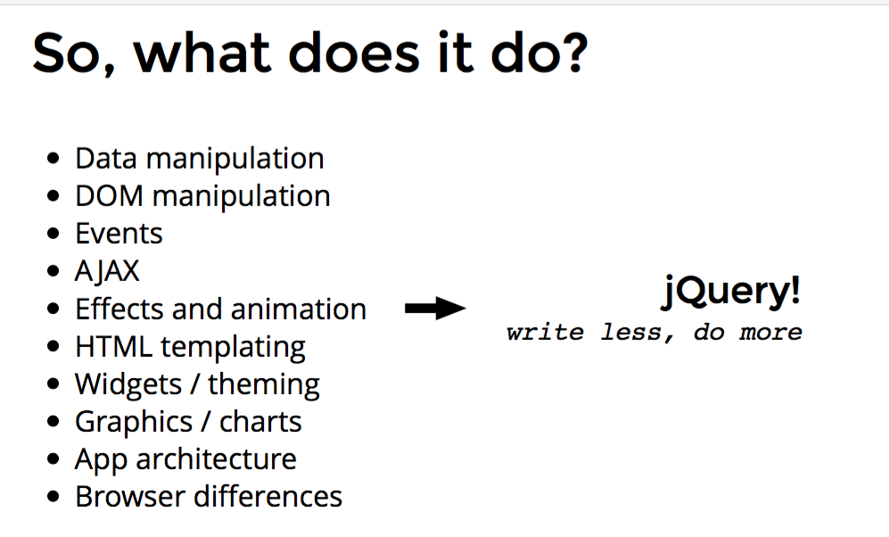
$
jQuery
Magic
When use a jQuery function, it creates an array
Can do almost anything
Use it when you can
var $newArray = $ (“element from the DOM ie the tree”)
Can then use $newArray in any way you would use an ordinary array – plus other clever jQuery

Slide 25
Events
Manage interaction with users and others. Really an “if”
Event
eg Type key A
Callback
Show the character A on the screen
Event listener
When a particular event happens do this ie if event happens do the callback

Slide 26
Type of events
Keyboard
Mouse
Form
Browser events
$("#btn).on("click", function(){})
keydown
keypress
on click
dblclick
hover
mousemove
contextmenu
Focus - when click someone is the focus
Blur - when they clikc out of something
Change
Selecct
Submet
resize
?
?

Slide 27
Timers – help manage events – callback happens at a certain time ie passing of time is an event.
window.setTimeout | delay
window.setInteral | call it regularly

Slide 28
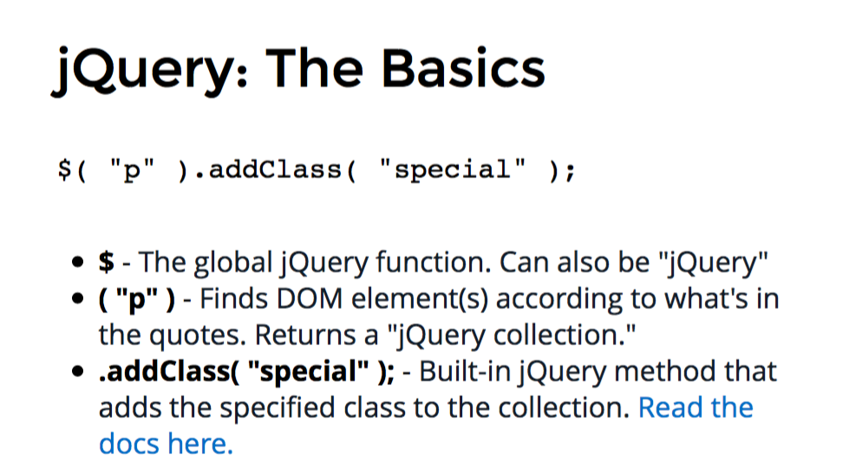
jQuery
Select
Manipulate
Admire or inject
$
Official jQuery library

Slide 29
$(document).ready(something); says: "when the HTML document is ready, do something!" (We'll show you how to replace something with an action in the next exercise.)
Tells the computer to load the jQuery functions as soon as the html page has loaded

Slide 30
Databases - SQL

Slide 31
Pulling all the content together dynamically

Slide 32
Connecting content together – with Sinatra
Public folder
Content
layout.erb
Views folder
Layout
main.rb use erb :"/” (fat controller)
<% yield %> to import the content
<% blah %> when
Data (sqlite3)
Use .db page
Actual pages of content
.sql pages for input etc CRUd

Slide 34
Connecting content together – using Active Record
Public folder
Content
layout.erb
Views folder
Layout
main.rb use erb :"/” (fat controller)
<% yield %> to import the content
<% blah %> when
Data (sqlite3)
Use main.db page
Actual pages of content
.sql pages for input etc CRUd
require the Active Record
add some stuff at the top of the document to connect to the databases
add the active record stuff to each part of the main.rb to direct it where it goes

Slide 35
Connecting content together – using Active Record
Use main.db page
require the Active Record
add some stuff at the top of the document to connect to the databases
add the active record stuff to each part of the main.rb to direct it where it goes
add the logger so that you can see errors
create the class so that you can inherit the commands from ActiveRecords
all animals
get - just shows the form
post - create a new instance of the class animal and assign all values to be the same things as in the form
Save animal to database animal.save
delte - find animal using ID from url and destroy it
animal.destroy
edit page - find the animal using the ID from the URL (ie params)
POST TO THE ANIMALS
Find all animals
update the attrributes
redirect
Get

Slide 36
Tools
pry
sqllite3 database.drb < file.erb
in the document
binding.pry at end of document but something after it
in the console "exit" from pry
erb files??
ruby
run it from the console ruby main.rb
require 'pry'
run the database first
Pulling content together dynamically
Sinatra

Slide 37
Where can I get data from
database
params – created by RUBY??

Slide 39
YUK FROM HERE

Slide 40
To launch a function on a key event | var myCallback = function (){} $(#bthn).on(“click”, myCallBack);

Slide 41
This sets an alert when the word “toggle” is clicked
Need to make sure that the document is referenced – see Jack’s slides in patterns – solves the problem of order of reading things. NEED TO MAKE SURE THE DOCUMENT IS READY
$(document).ready(function(){}
Jack prefers the other one – see his slides – attach events to something global and be explicit about what you care about.
$(document).on(“click”,”a”,function)
Jack prefers this one – see his slides – attach events to something global and be explicit about what you care about.
Put your script is at the end

Slide 42
This sets an alert when the word “toggle” is clicked
Do something on a click | $("#toggle").on("click", function(){ alert("Toggle clicked");}); | On is provided by jQuery Toggle is a jquery function built in
 | $("#toggle").on("click", function(){ $(".triple-kitty1").toggle(1500) | Find the word toggle On click run the function of toggle using triple-kitty1 – toggle for a certain period of time
 |  | Mousemove
 |  | mouseclick

Slide 43
jQuery
select | $(”css.selector”)
manipulate | Addclass.
create | $(“<p>”)
Add to the page | $(destinationelement).append($p) or prepend

Slide 44
jQuery Plugins
Best website for plug-ins – javascripting.com – use this
See also pamelafox – jquery
Make sure the plug in reference comes after the jquery file, and before your script for js.

Slide 45
Chaining – shorthand for jQuery
Callback hell – bad code – functions calling functions
When using for - keep loops small
Try and give the function only the information it needs.
Main thing event.preventDefault – stops the browsers default behaviour
Use when
Don’t want to follow a link, but want to use it
Don’t want to submit a form – but have form validation
If you want to be a jerk or eg you don’t want people to be able to save your photos etc.
iFrames – way of showing another website on your page

Slide 46
Additional libraries
Sweetalerts
Css animators

